Slide 1
Principles for Interconnection
Breakthrough Agenda

Slide 2
Overview
Cross border interconnection offers major opportunities to scale up renewables, enhance energy security and promote sustainable development.
For example, in the Asia-Pacific region, achieving 15% cross-border electricity trade by 2040 could unlock:
Value
Emissions saved
US$493 billion
3.07 billion tonnes CO2e
Source: SunCable
The Principles for Interconnectors paper provides a starting point guide for policy makers and developers starting multi-country discussions on developing an electricity interconnector project.

Slide 3
Life Cycle Stages
Concept
Project Development
Operation
Decommissioning
1.1 Preliminary feasibility studies
1.2 Feasibility studies
1.3 Permitting
1.4 Regulatory approval
1.5 Approval mapping
1.6 Financial planning
1.7 Capital raising strategy
1.8 Preliminary financing
1.9 Peer-to-peer dialogue
2.1 Cost-sharing
2.2 Financing modality
2.3 Project financing
2.4 Project implementation / execution / construction
2.5 Project monitoring
2.6 Project Regulation
3.1 Operation protocol
3.2 Agreed operating protocol for the integrated transmission system
3.3 Trading arrangements
3.4 Operation
4.1 Assessment of prolonging life
4.2 Decommissioning of transmission infrastructure
4.3 Agreed procedure for the decommissioning of all relevant transmission infrastructure at end of life
Notes:
To note draft principle life cycle stages – July 2023

Slide 4
1. Concept
Principles:
Processes of the concept stage
Preliminary studies should address all social economic welfare factors
Studies should be conducted by credible third parties
Feasibility studies should include input from all affected parties
Interconnectors should be considered as part of larger power system plans
Cost Benefit Analysis should measure social economic welfare of the project
Initial studies to find out if a project is economically and technically viable
Undertake consenting and feasibility studies
Engagement with regulators and Transmission System Operators (TSOs)
Establish if both governments have endorsed the project

Slide 5
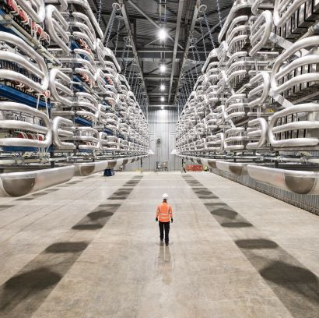
3. Operation
Principles:
A trilateral agreement covering the coordinated operation of the interconnector must be agreed and updated.
Develop clear lines of communication for emergencies, planned outages, and shared maintenance.
There should be a legal framework agreement underpinning the trade over an interconnector.

Slide 6
2. Project development plan
Principles:
Government A
Government B
Setting up a trilateral forum between governments, regulators and operators and/or developers is advantageous. It can cover:
Regulatory frameworks for managing the costs and revenues associated with the project.
Developing a pathway for regulatory arrangements.
Apportionment of costs between countries.
Agreement of project boundaries with TSOs.
Regulator A
Regulator B
International
Development forum
Transmission System Operator A
Transmission System Operator B
Developer

Slide 7
Next steps
Test findings and consult with states in Asia-Pacific bilaterally.
To publish the Principles for Interconnectors at Singapore International Energy Week / COP28.

Slide 8
Acknowledgements
Thank-you for listening!
With special thanks to our colleagues in the GGI Asia – Pacific Working Group Taskforce for their contributions so far:
Asia Development Bank ASEAN Centre for Energy Climate Compatible Growth (CCG) Climate Parliament Deloitte E3G Green Climate Fund International Energy Agency (IEA) Integrated Research and Action for Development (IRADe) | International Renewable Energy Agency (IRENA) National Grid OFGEM Mekong8 SAARC Energy Centre Sustainable Energy for All Sun Cable Renewable Energy Institute Regulatory Energy Transition Accelerator (RETA) Government of Bhutan | UK Foreign Office UK Department for Energy Security and Net Zero UN Economic and Social Commission for Asia and the Pacific UNOPS
For more information, please visit: https://www.greengridsinitiative.net/
Email: Rob.Cooke@energysecurity.gov.uk

